Slide 1
Software Requirement Engineering
Tracing Requirements
Muhammad Nasir
m.nasir@iiu.edu.pk

Slide 2
Outline
What is Traceability?
The Traceability Relationship
A Generalized Traceability Model
Traceability Matrix
Traceability Tools
Proceeding without Traceability Tools
Traceability and Software Verification

Slide 3
What is Requirements Traceability?
Traceability is the "ability to describe and follow the life of a requirement, in both forward and backward direction, ideally through the whole system life cycle“. (Arnold, R. and Bohner, S., 1996)
Traceability becomes a kind of roadmap to the Project.

Slide 4
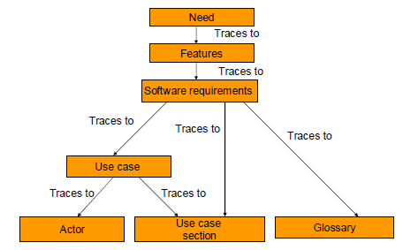


Traceability Relationships

Slide 5
Traceability Definitions
The degree to which a relationship can be established between two or more products of the development process, especially products having a predecessor-successor or master subordinate relationship to one another; for example, the degree to which the requirements and design of a given software component match." (IEEE 610.12-1990 §3)

Slide 6
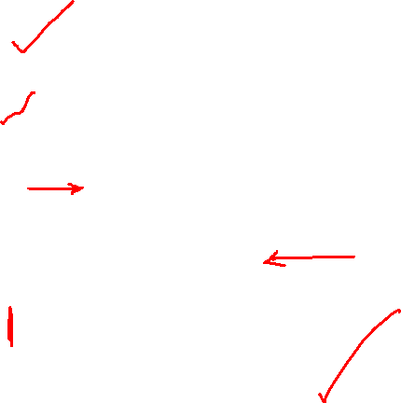

What Is Requirements Traceability
Business Needs
drive
Customer Needs
which drive
User Needs
which demand
Product Features
that drive
Software Requirements
that we developers
Implement and Test

Slide 7
Significance of Traceability
Historical safety data has demonstrated that missing or un-addressed requirements
and/or the impacts of changes are often missed and that small changes to a system can create significant safety and reliability problems.
This has caused some regulatory agencies to mandate traceability as an integral part of the development process.

Slide 8
Traceability Model & Artifacts
Different projects drive different types of requirements artifacts and different ways of organizing them.
These decisions, in turn, drive differing needs for the number and nature of the artifacts to be traced.
Generally, a Traceability model follows a hierarchy from higher-level needs and features through more detailed requirements, and then on into implementation and testing.

Slide 9
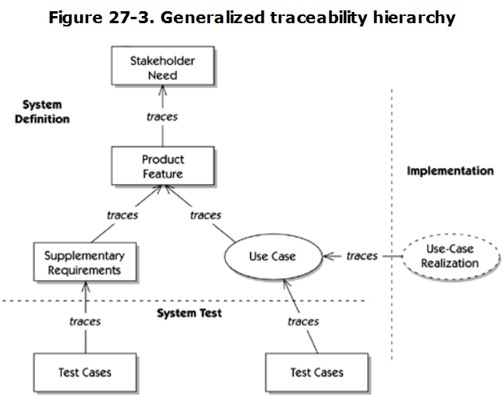
Traceability Model

Slide 10
Tracing User Needs to Features
Understanding user needs is some of the most valuable time you can spend on the project.
Defining the features of a system that meets those needs is the next step in the process,
and relating how the user needs are addressed by the features of your proposed solution.
We can do so via a simple table, or traceability matrix

Slide 11
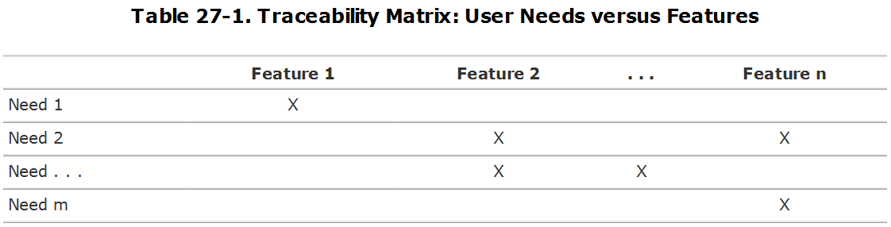
Tracing User Needs to Features

Slide 12
Tracing User Needs to Features
If inspection of a row fails to detect any Xs, a possibility exists that no feature is yet defined to respond to a user need.
If inspection of a column fails to detect any Xs, a possibility exists that a feature has been included for which there is no defined product need.
This may indicate a gratuitous feature, a misunderstanding of the role of the feature, or a dead feature

Slide 13
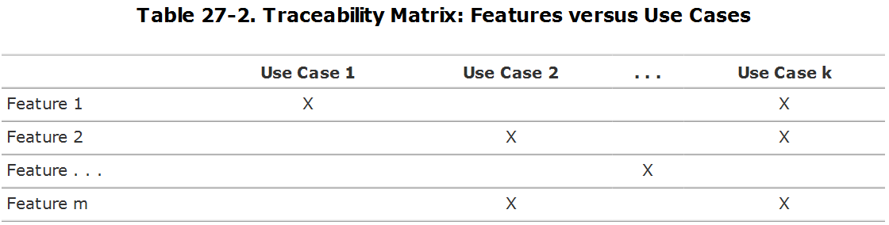
Tracing User Features to Use-Cases

Slide 14
Tracing Use-Cases to Test-Cases
This is a one-to-many relationship since an elaborated use case will typically have a variety of possible scenarios that can be tested.
From a traceability viewpoint, each use case traces to each scenario of the use case

Slide 15
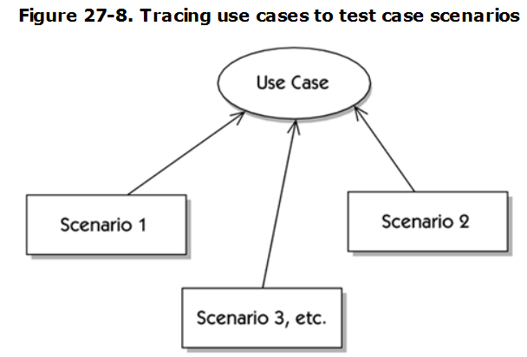
Tracing Use-Cases to Test-Cases

Slide 16
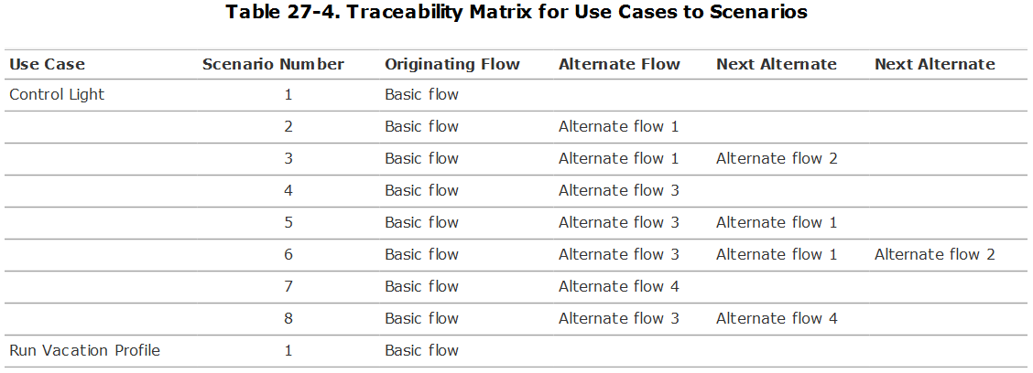
Tracing Use-Cases to Test-Cases

Slide 17
Tracing Use-Cases to Test-Cases
However, we are still not done because each scenario can drive one or more specific test cases, as illustrated in Figure 27-9.
However, in matrix form, this simply adds one more column to the matrix

Slide 18
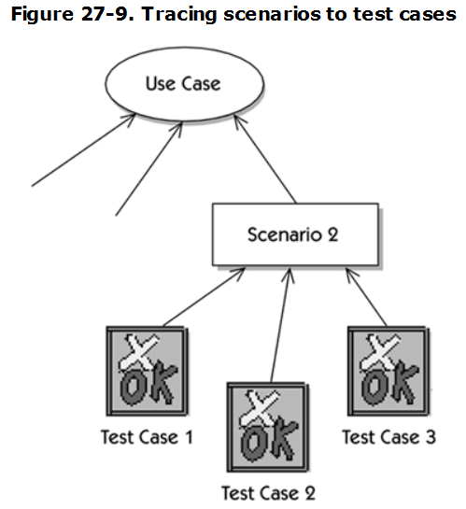
Tracing Use-Cases to Test-Cases

Slide 19
Using Traceability Tools
Powerful software requirement management tools offer a simple user-guided procedure to "point and click" through the explicit relationships that may exist between two elements of the lifecycle.
Using these tools provides you with a more efficient way to take on larger projects than using the manual matrix methods discussed earlier.

Slide 20
Modern Traceability Tools
ReQtest...
Visure Requirements
Quip...
TraceCloud...
iRise...
Visual Trace Spec...
IBM Rational DOORS...

Slide 21
Proceeding without Traceability Tools
Many of the matrix relationships could be easily handled with a spreadsheet.
The problem with spreadsheets, however, is maintenance, especially in extensive hierarchies of relationships.
Changing a single linkage could have far-flung impacts in the relationships at issue, as well as other relationships in other parts of the hierarchy.
It could become a nightmare if extensive changes to the linkages had to be made.

Slide 22
Proceeding without Traceability Tools
The other alternative is to use a database.
We used relational databases extensively and found it fairly easy to construct them and to input the data.
Indeed, in the pre-tool days, we used relational databases to support traceability requirements

Slide 23
Proceeding without Traceability Tools
Therefore, although you can use spreadsheets or databases to maintain the traceability relationships, it won't be easy.
If you have a small project, the pain and suffering will be minimal, and it might be worth considering simpler alternatives.
On the other hand, we do not recommend tackling larger projects without the use of specialized requirements management tools.

Slide 24
Why to use traceability?
Assure quality
  Verify the implementation fulfills all requirements
  Verify the application does only what was intended
Help manage change
  Understand the impact of a change
  Find related requirements

Slide 25
Traceability and Validation
Traceability is an effective technique which supports system verification activity.
A significant factor in quality software implementation is the ability to trace the implementation through the stages of specification, architecture, design, implementation, and testing.

Slide 26
The End
Thanks for listening
Questions would be appreciated.

